Slide 1
Final report
Professor : 黃敬群 博士
Presenter : 郭王鼎志

Slide 2
Outline
Goal
Challenge
Our system
Experimental Results
Contact information

Slide 3
Outline
Goal
Challenge
Our system
Experimental Results
Contact information

Slide 4
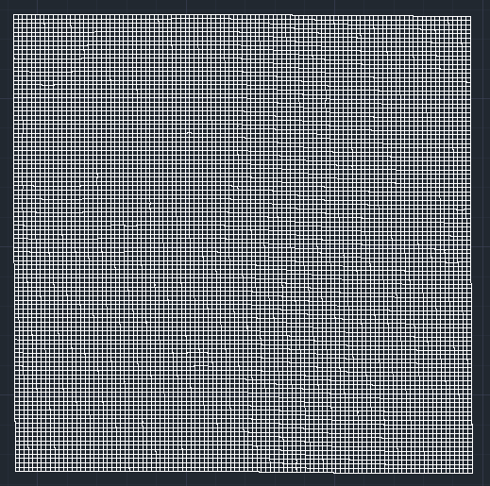
Goal
To transform the scanning data into Autocad Coordinate then draw it.
scanning data

Slide 5
Outline
Goal
Challenge
Our system
Experimental Results
Contact information

Slide 6
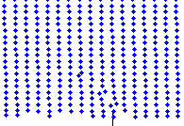
Challenge
Error scan point
Real point

Slide 7
Outline
Goal
Challenge
Our system
Experimental Results
Contact information

Slide 8
Our system
System flow
Execute the program
Load .*arx file and Call the function
Select the input data
NO
*.txt
Yes
Format
Execute the algorithm
Input data 6*N the *.txt
(N : Number of samples)
Output 1*N the *.scr file
Output 1*N the *.dwg file
*.scr
Output the processed points coordinate and command
Yes
Read the script and output CAD file
Next file
NO
End
8
*.dwg

Slide 9
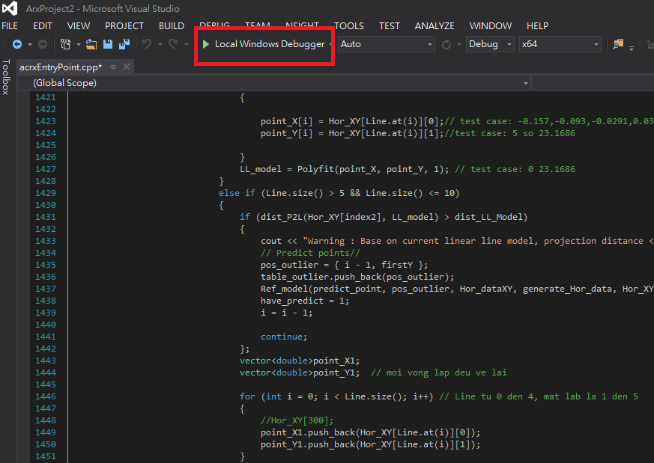
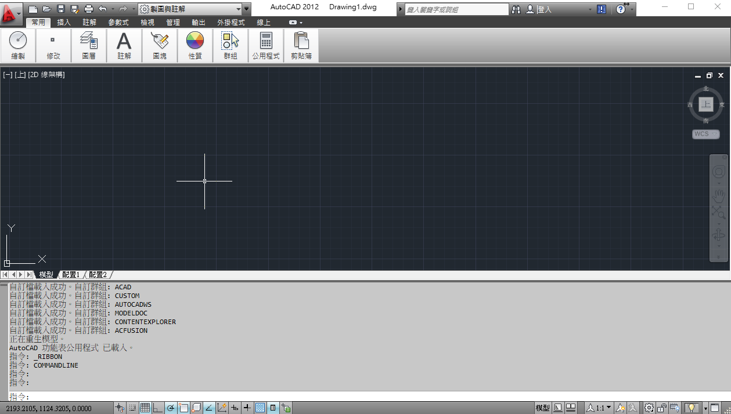
Execute the program

Slide 10
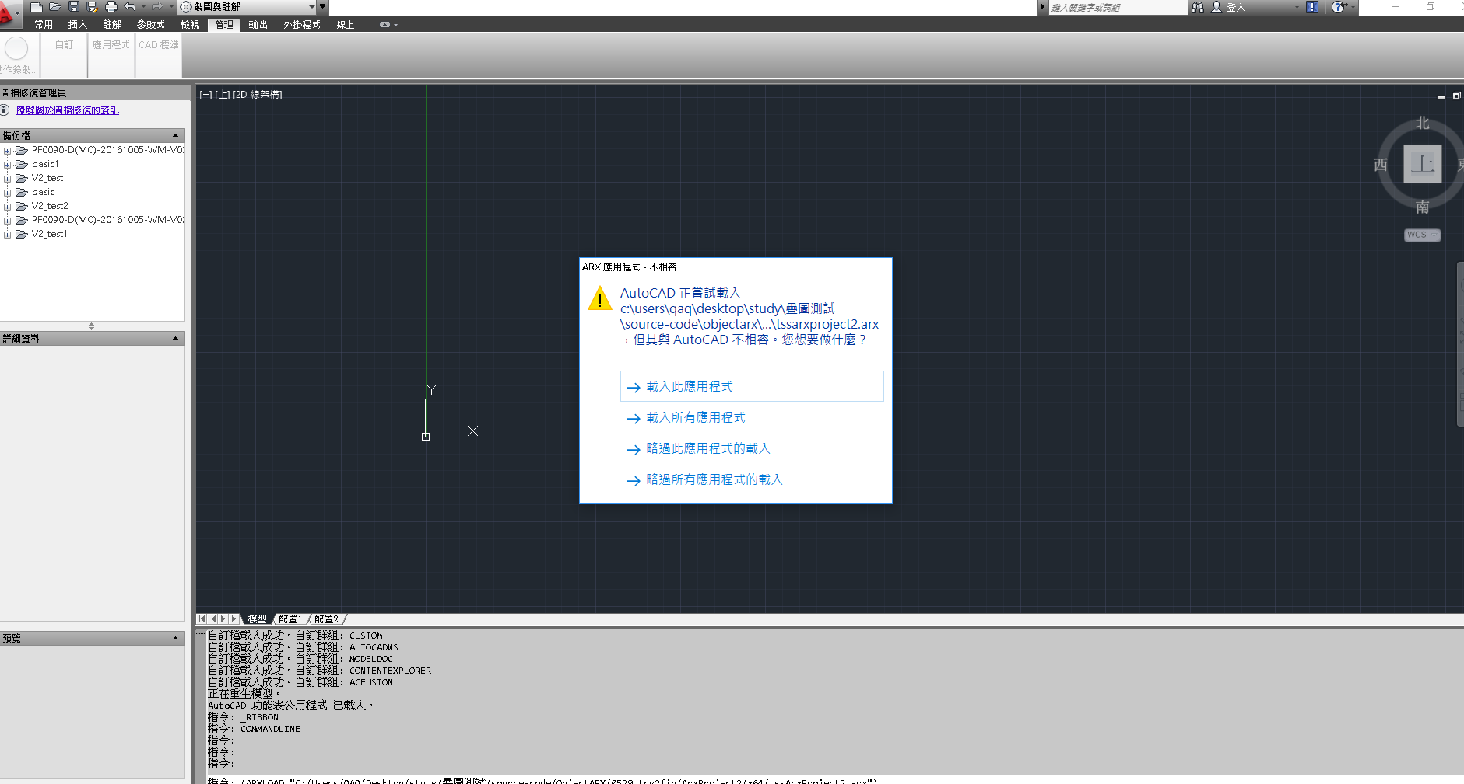

Load .*arx file Call the function

Slide 11
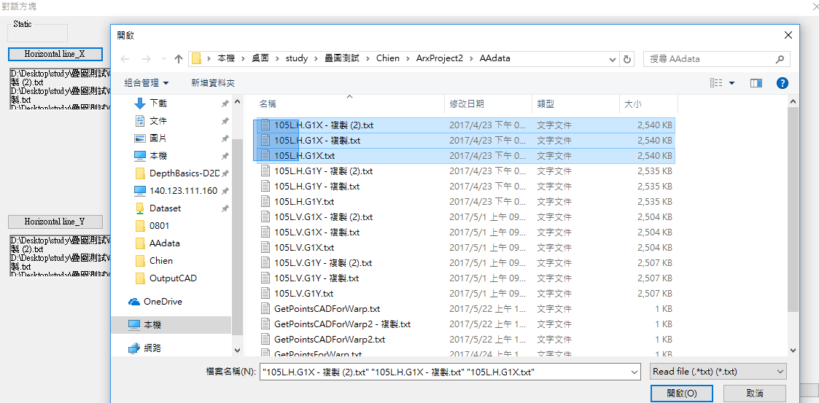
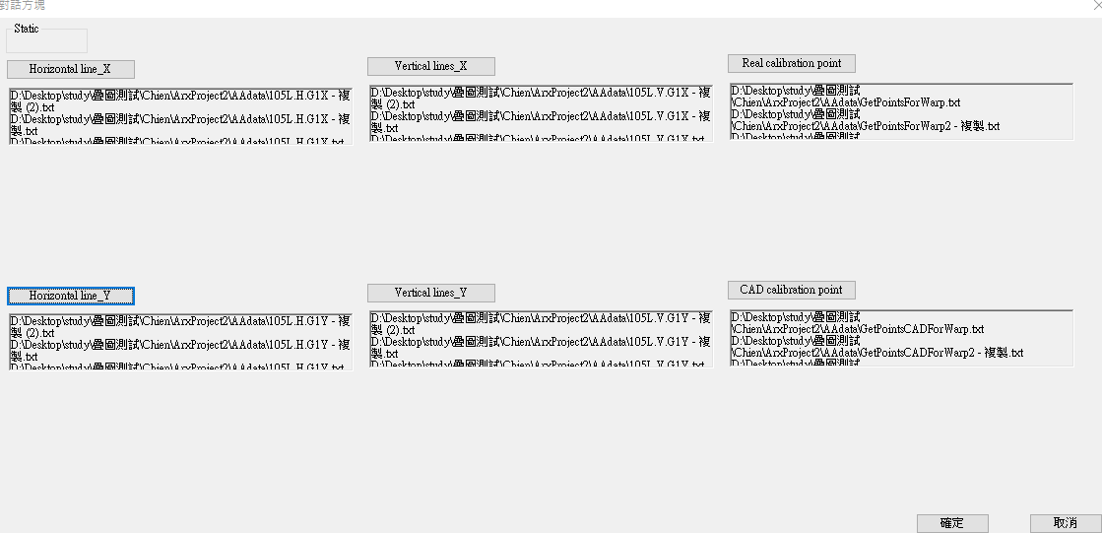
Function and interface

Slide 12
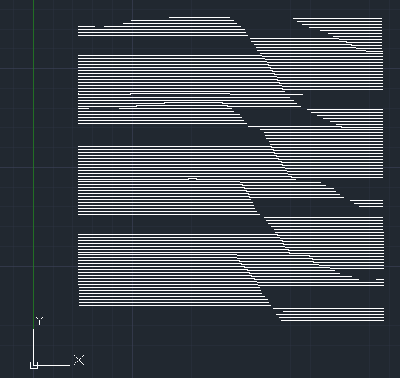
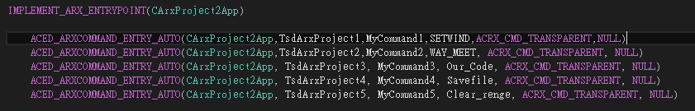
Execute the algorithm
Function define:
WAY_MEET : Open the interface to select the input file.
Our_Code : Execute the algorithm
SETWIND : Draw the CAD *.dwg file
Savefile : Save the *.dwg file
Clear_range : To clear the content

Slide 13
Overview Flow Chart
Load the data and Build the Quantization table
Initial Point and Linear Line model
Group the point to line- Update model
Build the CAD file

Slide 14
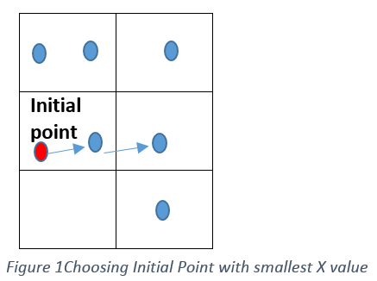
Load the data and Build the Quantization table
Initial Point and Linear Line model
Group the point to line- Update model
Build the CAD file
Initial Point
Find the 5 points
Constraints(CT):
Closest point in right side, 0.055<distance<0.065
The next points, and the current point should make the vector quite similar to the line below. (we use this constraint if we had the reference model below)
Make a Line from 5 points by optimization projection errors
Build linear line model
Projection error

Slide 15
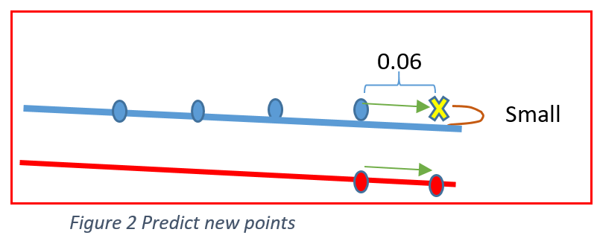
Constraints1(CT1):
Closest point in right side, 0.055<distance<0.065
Base on current linear line model, projection distance < Threshold
Has the same direction with reference model.
Load the data and Build the Quantization table
Initial Point and Linear Line model
Group the point to line- Update model
Build the CAD file
Start new Initial points in next Line(previous step)
Linear Line model
Yes
Find next Points (CT1)
End Line?
NO
NO
Print the warning message and pause “Outliner(X,Y) “
Constraints (CT2):
The prediction points satisfy these constraints:
Distance with previous point =~0.06
Distance with current linear line model is small. (threshold)
Has the same direction with reference model.
Yes
Update the model
Predict next points
(CT2)
Update next points to line model
Contain 10 points?
NO
Yes
Remove the first and of date the last points to model
Note: when we update new points to current model. We also need to move the reference model to next points vector

Slide 16
Fixing the function of the reference model
Complete the reference model
: Input points
: Incomplete lines
: Output points
: Predict points
Outliers
First line

Slide 17
Outline
Goal
Challenge
Our system
Experimental Result
Contact information

Slide 18
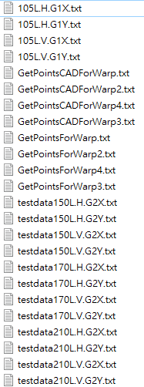
Experimental Result
Input data
Horizontal X axis coordinates
Horizontal Y axis coordinates
Vertical X axis coordinates
Vertical X axis coordinates
Calibration point from AutoCAD
Calibration point from scanning

Slide 19
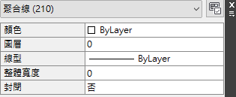
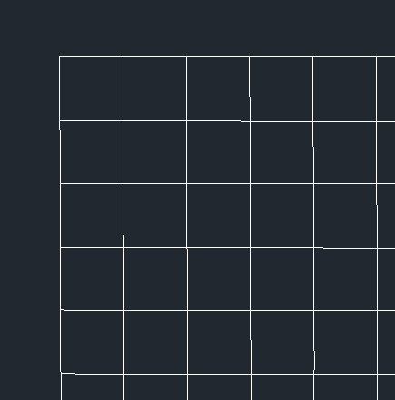
Experimental Result (1/4)
Output data
Horizontal Line 105
Vertical Line 105

Slide 20
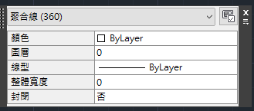
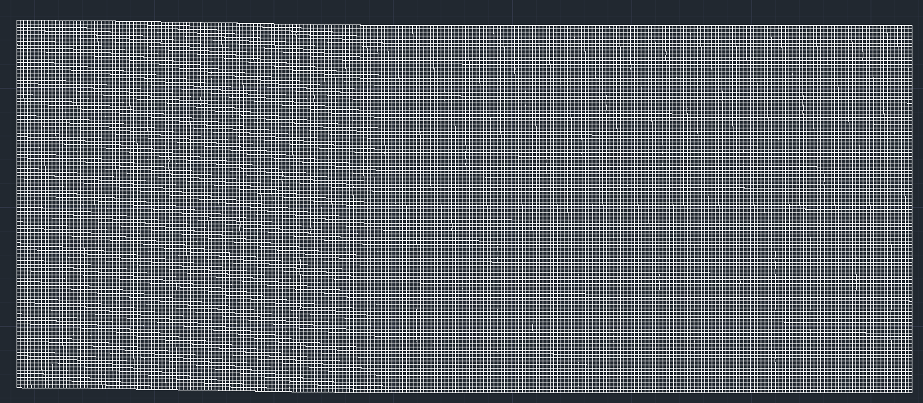
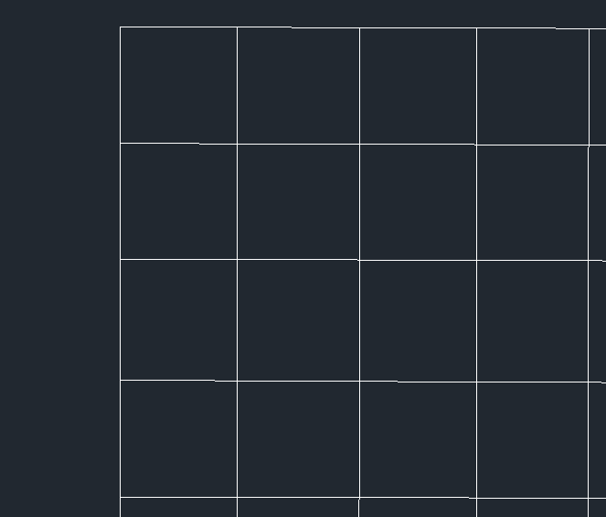
Experimental Result (2/4)
Output data
Horizontal Line 105
Vertical Line 275

Slide 21
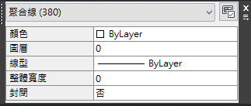
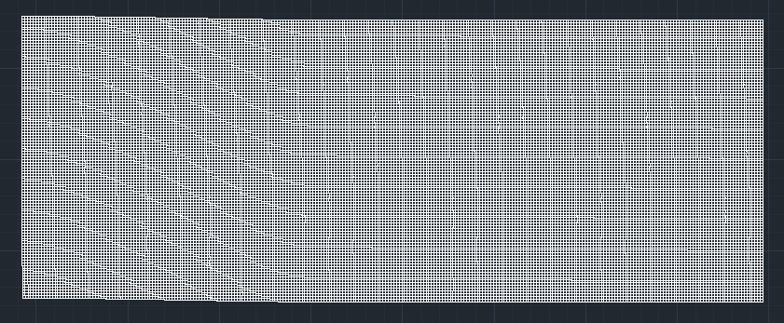
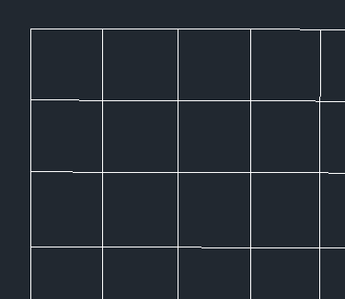
Experimental Result (3/4)
Output data
Horizontal Line 105
Vertical Line 275

Slide 22
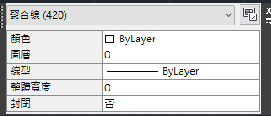
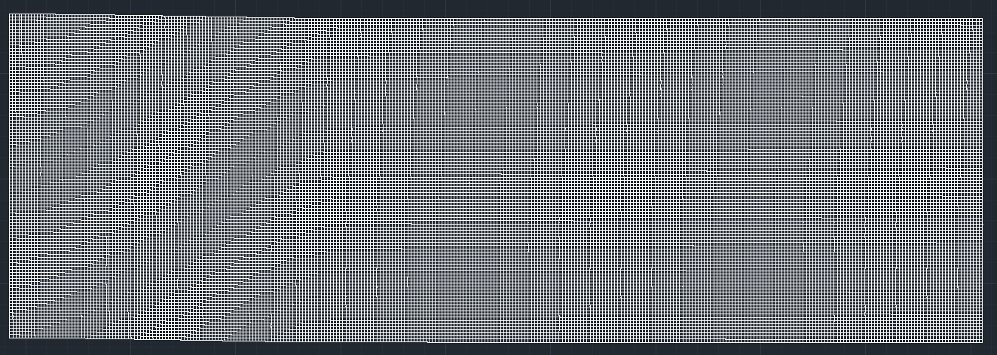
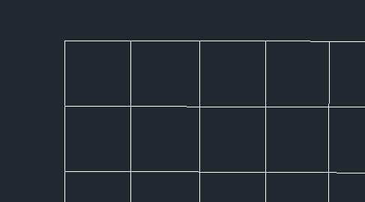
Experimental Result (4/4)
Output data
Horizontal Line 105
Vertical Line 315

Slide 23
Outline
Goal
Challenge
Our system
Experimental Results
Contact information

Slide 24
Contact information
黃敬群博士
國立中正大學
電機工程學系
應用運算與多媒體實驗室
http://acm.ee.ccu.edu.tw/
聯絡電話：05-2720411#33223
電子郵件：chingchun.huang6@gmail.com

